Slide 1
Azure Serverless
Thiago Almeida
@nzthiago
Katy Shimizu
@kashimizMSFT
Dutch Azure Meetup 7 February 2018

Slide 2
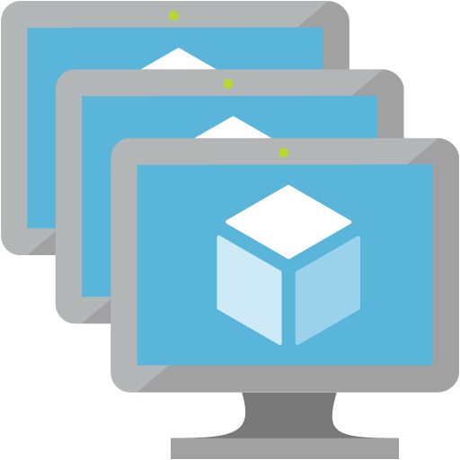
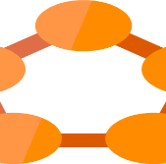


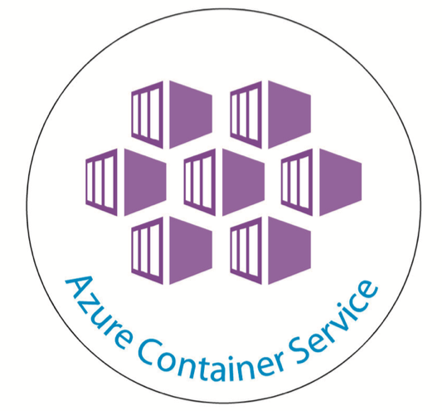

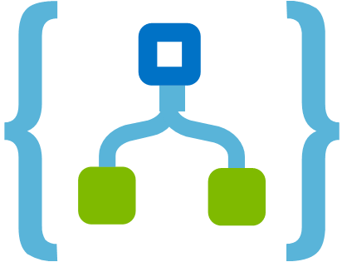
Azure Compute Options
IaaS
PaaS
Serverless
Azure Virtual Machines VM Scale sets Azure Container Service
Azure App Service Service Fabric Azure Batch
Azure Functions Logic Apps Event Grid

Slide 3

Azure Compute Options
Productivity
Control
IaaS
PaaS
Serverless

Slide 4



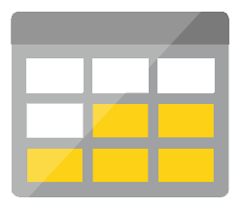




Serverless application platform components
Development
Platform
IDE support
Event Grid
Logic Apps
Functions
Manage all events that can trigger code or logic
Design workflows and orchestrate processes
Execute your code based on events you specify
Integrated DevOps
Local Development
Monitoring
Database
Storage
Security
IoT
Analytics
Intelligence
Visual Debug History

Slide 5

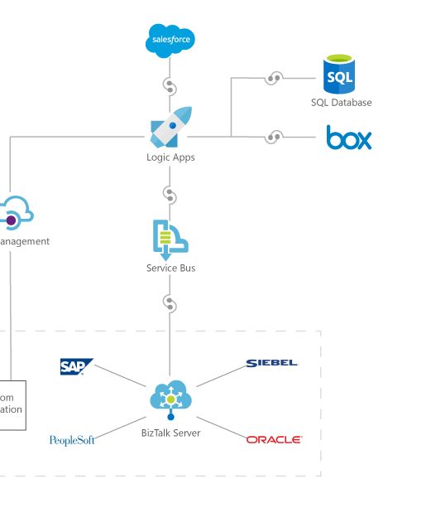








Connect anything
Azure SQL
Run mission-critical, complex integration scenarios with ease
Connect on-premises, hybrid and cloud applications
Position for the future with API centric connectivity
Easily connect custom on-premises applications to the cloud
Logic Apps
API app
Web app
API Management
On premises data gateway
2
1
SQL Server
BizTalk Server

Slide 6
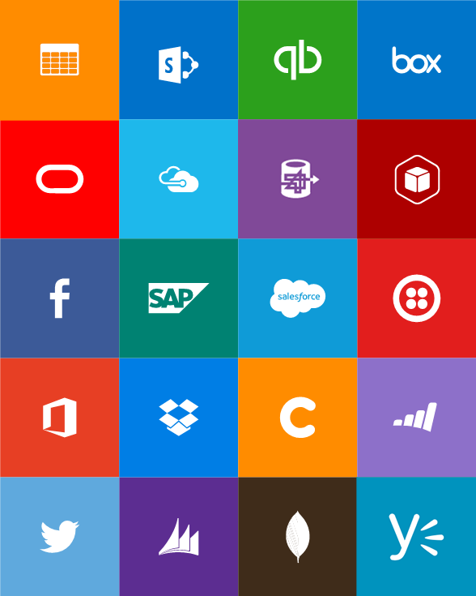
Out-of-box connectors
SaaS
Azure Service Bus
Azure Storage Blob
Bing Search
Box
Dropbox
Dynamics CRM Online
Facebook
GitHub
Google Calendar
Google Drive
Google Sheets
Google Tasks
Instagram
MailChimp
Mandrill
Microsoft Project Online
Microsoft Translator
Office 365
Office 365 Users
OneDrive
OneDrive for Business
Outlook.com
Project Online
Salesforce
SendGrid
SharePoint Online
Slack
SparkPost
SQL Azure
Trello
Twilio
Twitter
VSTS
Wunderlist
Yammer
YouTube
Protocols
Enterprise messaging
Hybrid
HTTP, HTTPS
HTTP Webhook
FTP, SFTP
SMTP
RSS
Delay
Workflow
Validate
Transform (+Mapper)
Convert (XML-FF)
X12
EDIFACT
AS2
IBM DB2
Informix
SharePoint Server
SQL Server
Websphere MQ

Slide 7
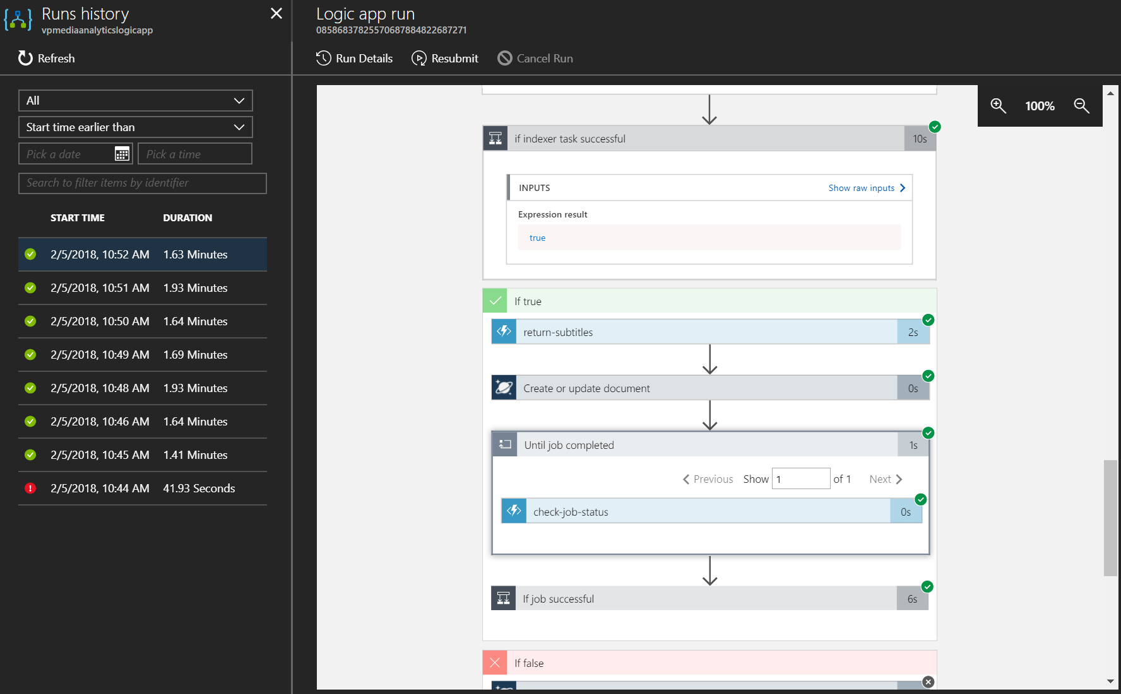

Slide 8

Event Grid

Slide 9











Modern computing is all about events

Slide 10
?
Managing events is important but cumbersome
?
?
?
?
?
?
?
?
?
?
?

Slide 11
Manage all events in one place

Slide 12
Event Grid guiding principles
Always available
Near real-time event delivery
At least once delivery
Dynamic scale
Platform agnostic (WebHook)
Language agnostic (HTTP protocol)

Slide 13
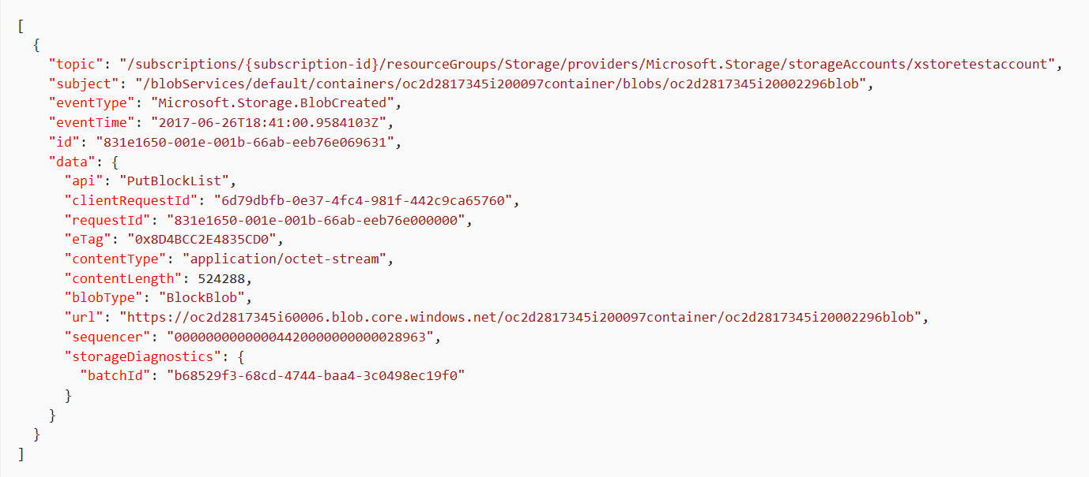
Event Schema
https://github.com/Azure/azure-rest-api-specs/tree/master/specification/eventgrid/data-plane

Slide 14
Security
WebHook Validation: echo back validation code
Event Delivery: query string token parameter
Event Subscription: write permission required on resource subscribed to
Topic Publishing: SAS token or key authenticated
Management Access Control: Role Based Access Check via ARM

Slide 15




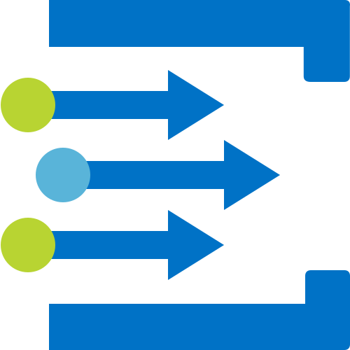




Scenarios
Serverless apps
Ops automation
Third-party integration
Trigger a function to run Cognitive API when a file is added to storage
Use a function to run a compliance check on each newly created SQL database
Use custom “drive start” and “drive end” events to log vehicle performance metrics
Tag newly provisioned VMs with Azure Automation and add to metadata store

Slide 16
News
Azure Event Grid is globally available in all major regions (including West Europe and North Europe)
24 hour retry policy with exponential back off for event delivery
99.99% availability with a financially backed SLA
Management and Publishing SDKs
https://docs.microsoft.com/en-us/azure/event-grid/sdk-overview

Slide 17
Learn more at azure.com/eventgrid
Ask on Stack Overflow aka.ms/gridquestions

Slide 18
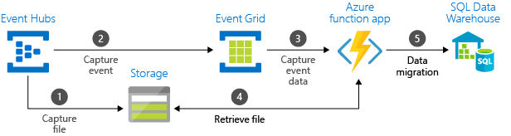
Demo - Stream big data into a data warehouse

Slide 19
Durable Functions with Katy
https://docs.microsoft.com/en-us/azure/azure-functions/durable-functions-overview

